Slide 1
Discussing and Documenting AI
Class Agenda
Talk about yourself: Self-Introductions (again)
Talk about ideas: Discussion of articles
Share your insights with the class
Learn how to document AI in class assignments
Thursday, Aug 28
COMP 608 | Fall 2025
Mary Glavan & Mack Joyner

Slide 2
Small Groups: Talk about Yourself

Slide 3

“Tell us a little about yourself…”
Imagine today is the first day of a competitive internship at a well-known software engineering company. The members of your small group are your fellow interns. You’re all meeting each other for the first time.
Your team leader starts the meeting by asking everyone to introduce themselves:
Image

Slide 4
Observe your small group:
What did everyone include in their self introduction?
What additional information did some people include but not others?
What information did people put at the beginning? Middle? End?
Did people stand or sit?
How did they use their hands? What did they do with their eyes?
What volume and pace did people speak at?
Notes:
Image: https://ageofthrivability.com/files/2019/01/1yzgJ-66YvsokIvqw93jiJQ.png

Slide 5
What information did people put at the beginning?
Name
Education
Middle?
End?
Place of origin
Interests
Projects
Family
Hobbies
Other?
Forward-looking statement (“I can’t wait to work with you”)
Compliment (“I’m so thrilled to be working with such a talented group of people”)
Other?
Notes:
Image: https://ageofthrivability.com/files/2019/01/1yzgJ-66YvsokIvqw93jiJQ.png

Slide 6
How do we know what to include?
What information did everyone include in their self introduction?
Name
Background
What was different about this self-introduction compare to Tuesdays?
More variety?
More connection?
Other?
Notes:
Image: https://ageofthrivability.com/files/2019/01/1yzgJ-66YvsokIvqw93jiJQ.png

Slide 7
Small Groups: Talk about Ideas

Slide 8
Step 1: Find a 2-3 friends (groups of 3-4)
Step 2: Verbally discuss the article that you read for today with your small group. Here are some questions to help your discussion:
Who wrote it and where was it published? Is this a reliable source of information?
When was it published? How up-to-date and relevant are the ideas?
What was it about? What were the main idea and and most memorable points, details, stories, or statistics?
What did you find interesting and why? What questions does it raise?
What does your group think about it?
How did the information influence your thinking about generative AI?
What does it mean to use generative AI ethically?
Step 3: Nominate at least one friend (more are welcome) to share with the class the most interesting ideas you discussed.

Slide 9
Why do we talk about our idea with other people?

Slide 11
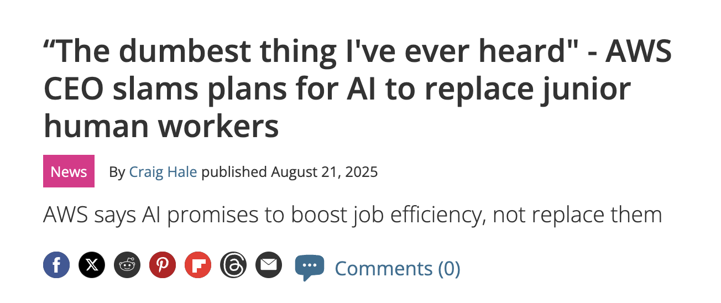
AI is here to augment skills, not erase opportunities.
Matt Garman, AWS CEO, encourages the use of AI tools to assist rather than replace junior talent
TechRadar

Slide 12
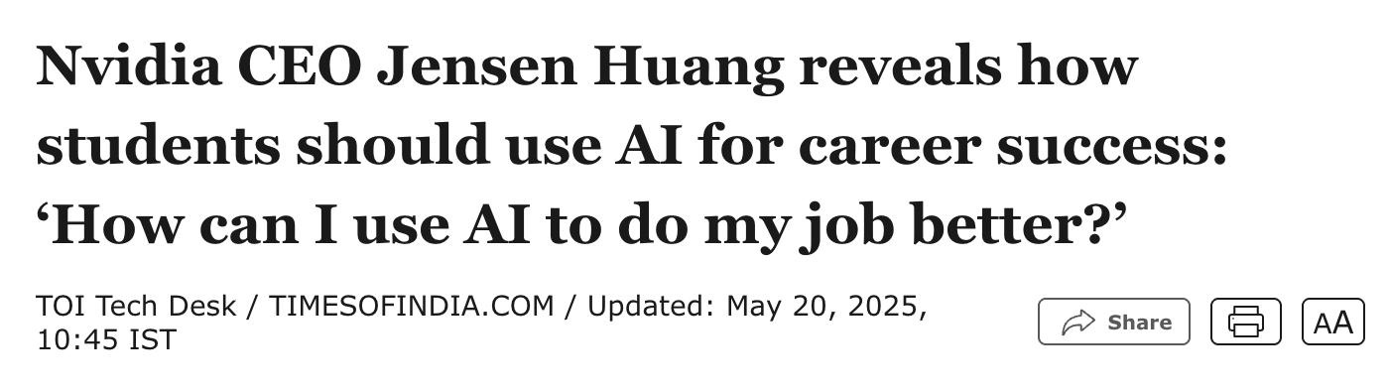
Use AI to Improve the Quality and Impact of Your Work
Huang emphasizes that understanding how to use AI improve job performance will become a critical advantage, regardless of your field or industry.
Times of India

Slide 13

Better Thinking, Better Prompts, Better Development
AI-assisted development now requires using natural language to articulate intent clearly to an AI model. Prompt engineering is becoming as important as programming itself.
Medium

Slide 14
In COMP 608, you are encouraged to use AI tools responsibly, transparently, accurately, and ethically.

Slide 15
Documenting genAI tools in your coursework

Slide 16
Key Principles
Transparency is essential: Disclose how and where you used AI tools.
Assignment-specific guidance applies: Each assignment will specify whether it follows an academic or professional style, which determines documentation expectations.
Accountability: You are responsible for reviewing, editing, and verifying all AI-assisted content.
Everytime you use a generative AI you are required to include an “AI Acknowledgement Statement”

Slide 17
When to write an
AI Acknowledgment Statement
When you use an AI tool to generate content–exact or revised.
When you use an AI tool to check style, tone, and grammar
When you use an AI tool to create images or visual content.
When you use an AI tool for research and brainstorming

Slide 18
How to write an
AI Acknowledgment Statement
Note the tool you used
Briefly describe what you asked the genAI tool to do and how you used the output. This could include: a) the first prompt, b) the last prompt, or c) a brief summary of all your prompts.
Briefly describe how you edited or treated any generated output.
Include a link to the conversation/transcript.

Slide 19
Example Acknowledgement Statement
I used ChatGPT3 to generate the final version of this email. After a series of prompts, I ended with: “Rewrite the email in under 150 words. Address Meera by her first name. Don't tell Meera what to do. Refer to specific evidence of the violation in an attachment. Use a more deferential tone.” I revised the output based on my understanding of the best communication strategies for this situation and to match my personal style. https://chat.openai.com/share/5009519e-7eec-4468-b4d3-20ca818a97d0”

Slide 20
Where to put your Acknowledgment Statement in your submissions
Academic-style assignments
Put Acknowledgement Statement in your document at the end.
Applies to summaries, Canvas discussion board posts, written summaries, reports, memos, proposals, and slides.
Professional-style assignments
Put the Acknowledge Statement in a separate document or in the Canvas submission comment
Applies to Concept Quiz answers, most homework assignments, emails, cover letters, LinkedIn posts, and interview responses.

Slide 21

Does this student correctly document their AI use according to the course guidelines?
Assignment
Communication Practice #1
AI Use: Student used ChatGPT-4 to suggest clearer phrasing and a more professional tone for their final paragraph about ethical AI use. The content itself was written by the student, but several sentences were lightly reworded based on AI suggestions.
Acknowledgment Statement: I used ChatGPT-4 to improve the tone and clarity of my response to the final question about ethical AI use. I wrote the content myself, then asked ChatGPT to suggest smoother sentence structures and more professional wording. I reviewed its suggestions carefully and chose which ones to adopt. Transcript: [URL]
Acknowledgment Placement: Included at the end of the discussion post, following the student’s response.

Slide 22

Does this student correctly their AI use according to the course guidelines?
Assignment
Communication Practice #1
AI Use: The student asked Claude.ai to “write me a really good example of a prompt I could share in my class about using AI tools.” They then copied the prompt Claude generated and submitted it as their own “favorite prompt” in the discussion post. The rest of the answers (favorite tool, use cases, ethics reflection) were written by the student.
Acknowledgment Statement: The student ended their post with:
“No AI tools were used to create this post.”
Acknowledgment Placement: N/A The student submitted without any disclosure.

Slide 23
Does this student correctly their AI use according to the course guidelines?
Assignment
Communication Practice #1
AI Use: Student used ChatGPT-4 to suggest clearer phrasing and a more professional tone for their final paragraph about ethical AI use. The content itself was written by the student, but several sentences were lightly reworded based on AI suggestions.
Acknowledgment Statement: Instead of including a statement, the student ended their post with:
“No AI tools were used to create this post.”
Acknowledgment Placement: N/A. The student submitted the discussion post without any acknowledgment statement.

Slide 24
Does this student correctly their AI use according to the course guidelines?
Assignment
Communication Practice #3
AI Use: Student used ChatGPT-4 to generate a first draft of the email, asked follow-up questions about tone, and adapted the draft based on feedback from class readings on user-centered design. The student edited the output for tone, grammar, and fit with genre conventions before submission.
Acknowledgment Statement
I used ChatGPT-4 to draft and revise the email included above. I first asked it to generate a professional email requesting a deadline extension from a manager, and then refined my prompts to align more with the scenario given. I edited the output to improve tone and clarity based on class materials on user-centered communication. Transcript: [URL]
Acknowledgment Placement: Included below the email, as part of the Canvas discussion post, which in line with professional-style document guidance for discussion assignments.

Slide 25
Does this student correctly their AI use according to the course guidelines?
Assignment
Communication Practice #3
AI Use: The student drafted their email to their manager entirely on their own. While typing, the Grammarly desktop app automatically flagged grammar and tone issues in real time. The student accepted one suggestion (replacing “I can’t meet the deadline” with “I may need additional time to meet the deadline”) but ignored most of the others.
Acknowledgment Statement: The student submitted the email and reflection paragraph without any acknowledgment.
Acknowledgment Placement: None included. Because Grammarly was running in the background automatically, the student didn’t consciously think of this as “using AI.”

Slide 26
Key Takeaways for Documenting AI Use in Coursework
Be Transparent: Always include an AI Acknowledgement Statement if you used an AI tool, even for grammar or tone.
Follow Assignment Style:
Academic-style: Put the acknowledgment at the end of the document.
Professional-style: Add it in Canvas comments or as a separate note.
Be Accountable: You’re responsible for checking, editing, and verifying AI output.
Be Specific: State which tool you used, what you used it for, and how you reviewed it.
When in Doubt, Disclose: If you’re unsure whether to document AI use, include an acknowledgment.

Slide 27
What will you take away from today’s class?
Interesting ideas?
Communication strategies?
The names of one or two of your new friends?
How will you prepare for the next class? →Daily Schedule

Slide 28
Thinking with GenAI

